Slide 1
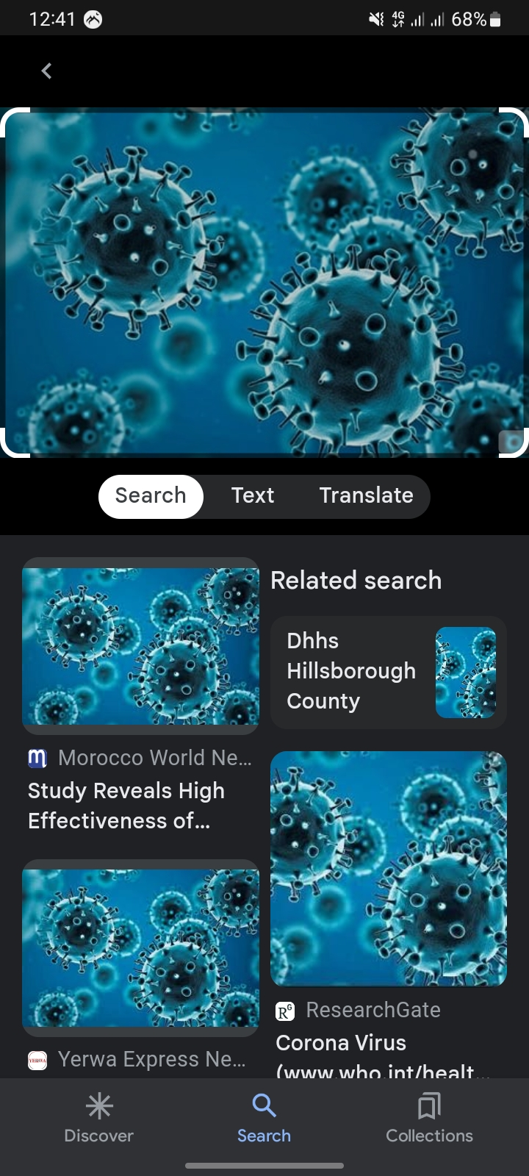
CORONA VIRUS 2019/2020 BY
MARYAM HUSSAIN
FE/23/39684605

Slide 2
INTRODUCTION
Corona virus also known as Covid19 is a pandemic disease that affected almost the whole world, it was first discovered in Wuhan, China in the year 2019.
The disease affects the respiratory system and makes the victim experience cough, fatigue, fever and chills, headache and many other symptoms.

Slide 3
AIMS AND OBJECTIVES
The aim of this project is to find out the number of victims affected or infected with the corona virus disease

Slide 4
METHODOLOGY
The data used in this project is a dataset from an online dataset source called KAGGLE.COM DATASETS, the dataset was cleaned and processed so as to be used in the presentation.

Slide 5
QUESTIONS
Which date has the highest number of victims or cases ?
What is the highest number of confirmed cases?
What is the number of new cases?
What is the rate of death from the disease?

Slide 6
FINDINGS AND INSIGHTS

Slide 7

What date has the highest number of victims?
From the analysis conducted, the date that has the highest number of victim is 13/03/2020,and its probably due to lack of knowledge on the disease and ways to prevent oneself from getting infected.

Slide 8
What is the highest number of confirmed cases?
The analysis shows that the number of confirmed cases is about 15709.

Slide 9
What is the number of new cases
The number of new cases gotten from the analysis is 627.

Slide 10
What is the rate of death from the disease?
The rate of death of victims of this disease from the analysis is low.

Slide 11
SUMMARY
The following dashboard wil give us a summary of the analysis.

Slide 12
RECOMMENDTION AND CONCLUSION
The community should be educated on ways to protect and prevent oneself from getting infected with the virus of coronavirus.
The government should provide healthcare workers with personal protective equipment(PPE) as it helps in reducing and preventing the spread of the virus from one patient to another.
Isolating centers should be mad available in all hospitals to separate infected people from non infected people.

Slide 13
THANK YOU FOR LISTENING!!!

